Slide 1


Emotional based media playback and stress monitoring system for Autism (Batch-A22)
TEAM MEMBERS:
SREENIDHYEE E (211418104260)
SRINITHEKA T (211418104264)
SUVETHA J (211418104282)
PROJECT GUIDE:
Mrs. A KANCHANA, M.E.
ASSISTANT PROFESSOR

Slide 2
INTRODUCTION
Autism spectrum disease affects the nervous system and impacts the overall cognitive ability, communication and interactive skills.
The common signs and symptoms encompass issues with verbal exchange, trouble with social interactions, obsessive hobbies, and repetitive behaviors.
The primary goal of this system is to capture an image in real-time and recognize whether it is a human face by using the Computer Vision technique. After detecting the human faces from live input, and examining the facial expressions using a Deep Neural Network.
Based on the predicted emotion audio is played using AT mega Microcontroller, which will keep them relaxed and will help them to learn.

Slide 3
LITERATURE SURVEY
Author | Title | Major Findings
Joao F. Santos, Nirit Brosh , Tiago H. Falk1 , Lonnie Zwaigenbaum, Susan E. Bryso , Wendy Roberts , Isabel M. Smith , Peter Szatmari and Jessica A. Brian (2013) [1] | Very Early Detection Of Autism Spectrum Disorder Based On Acoustic Analysis Of Pre-Verbal Vocalization Of 18-Month Old Toddlers | Many acoustic-prosodic options were extracted and training support vector machines and probabilistic neural is difficult. Classification accuracy as high as ninety-seven was obtained.
V. Y Tittagalla, R. R. P Wickramarachchi, N.M.D.M.B.Nanayakkara, P. Samarasinghe, P. Rathnayake and M.G.N.M. Pemadasa. (2019) [2] | Screening Tool for Autistic Children | This tool is formed particularly for distinctive youngsters with syndrome in rural areas in land. the key 3 areas of eye contact, vocal behavior, and responsiveness area unit the screening method.
Alanoud Bin Dris, Abdulmalik Alsalman, Areej Al-Wabil, Mohammed Aldosari (2019) [3] | Intelligent gaze-based screening system for autism | Results discovered that SVM accomplished high classification performance once applied on our collected eye movement information set.
Shirajul Islam, Tahmina Akter, Sarah Zakir, Shareea Sabreen, Muhammad Hossain (2020) [4] | Autism Spectrum Disorder Detection in Toddlers for Early Diagnosis Using Machine Learning | Among all applied algorithms KNN and Random Forest shows the most accuracy and speed the identification.

Slide 4
LITERATURE SURVEY
Author | Title | Major Findings
Zeyad Abdulhameed Taha Ahmed , Dr. Mukti E. Jadhav (2020) [5] | A Review of Early Detection of Autism Based on Eye- Tracking and Sensing Technology | The identification of syndrome within the early stage of life will facilitate unfit youngsters improve their social communication and quality of life
Uzma Hasan , Md. Fourkanul Islam , Muhammad Nazrul Islam , Sifat Bin Zaman , Shaila Tajmim Anuva, Farhana Islam Emu, and Tarannum Zaki (2020) [6] | Towards Developing an IoT Based Gaming Application for Improving Cognitive Skills of Autistic Kids | The recreation application that consists of recreation a puzzle game, an object finding game, and a road crossing game.
Sarah Afiqh Mohd Zabidi, Hazlina Md Yusof, Sukreen Hana Herman, Shahrul Naim Sidek (2021) [7] | Simple Touch Sensor- based Game as Ambient Assistive Device for Mild Autism Spectrum Disorder Children | The aim of this study is to create helpful device which will be a good learning medium for ASD kid and may be utilized by therapists throughout the session.
Guangtao Nie and Akshith Ullal , Zhi Zhen Amy R. Swanson, Nilanjan Sarkar(2021) [8] | An Immersive Computer-Mediated Caregiver child Interaction System for Young Children with Autism Spectrum Disorder | System designed for teaching IJA skills to kids with ASD incorporating caregivers within the loop to reinforce the potential for generalization within the real world.

Slide 5
PROBLEM STATEMENT
We will be using a Convolution Neural network Algorithm to detect Facial Emotion by using the Trained Model. We will be identifying the Emotion by comparing the Image of the Live Input with the Model file and then based on the Emotion we will Train the model by playing Rhymes when their Emotion is Happy.
We are also using Hardware such as Galvanic Skin Response Sensor where Electrodes is Connected to the Subject.
Based on the Threshold Values we will store the data in the Cloud Platform which becomes very useful for the Parents or Caretaker or Therapist to analyze their Mood Disorder as well. The reason for focusing on both these aspects are they might have possible anxiety when mingled with the crowd.
By Analyzing the Facial Emotion we can also help them learn things, we believe technology should reach all mediums of users and will help them overcome their problems.

Slide 6
DEVELOPMENT ENVIRONMENT
HARDWARE REQUIREMENTS
Arduino Mega
Node MCU
Liquid Crystal Display
Galvanic Skin Response Sensor
Power Supply
SOFTWARE REQUIREMENTS
Operating System - Windows 10
Machine Learning Framework – Open CV
Language – PYTHON
IDE- Arduino IDE, Python 3.8 IDE

Slide 7
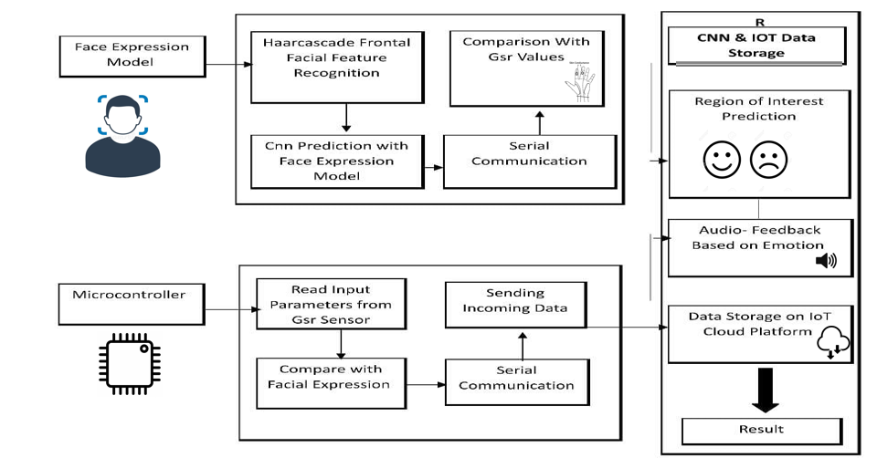
SYSTEM ARCHITECTURE

Slide 8
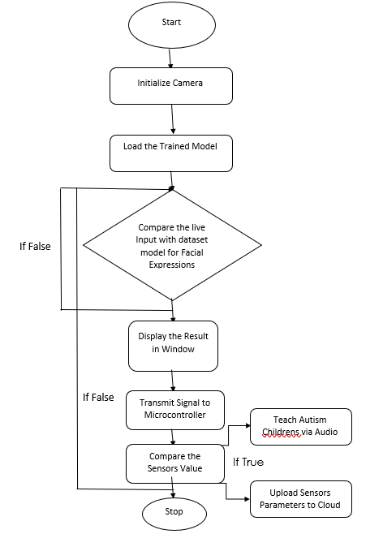
SYSTEM DESIGN
FLOW DIAGRAM

Slide 9
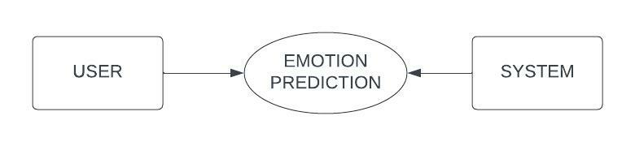
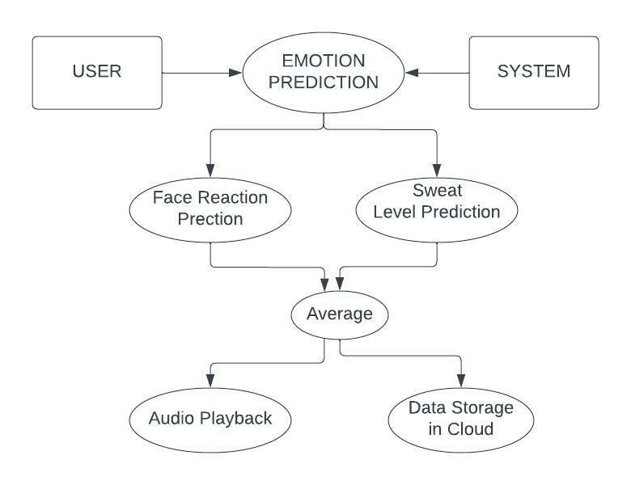
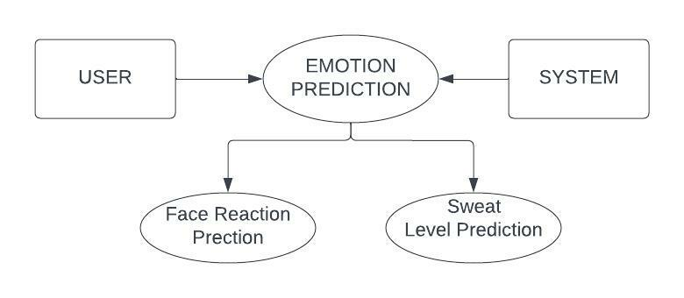
SYSTEM DESIGN
DATA FLOW DIAGRAM

Slide 10
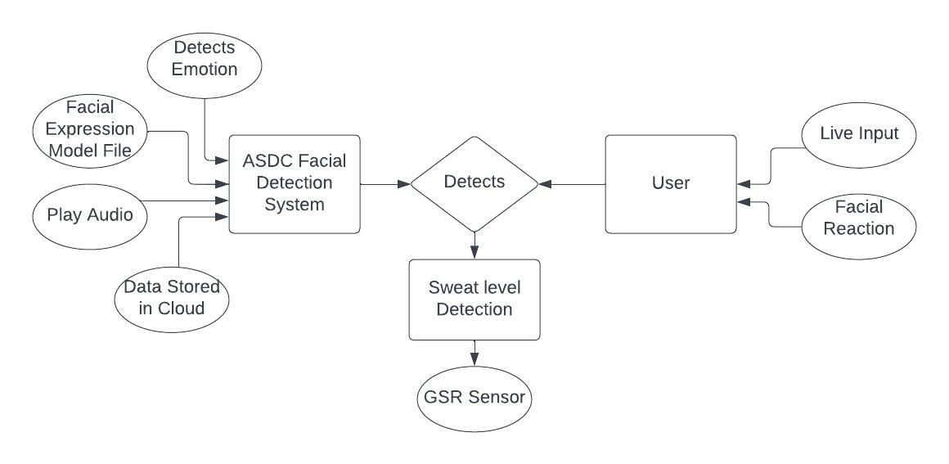
SYSTEM DESIGN
ER DIAGRAM

Slide 11
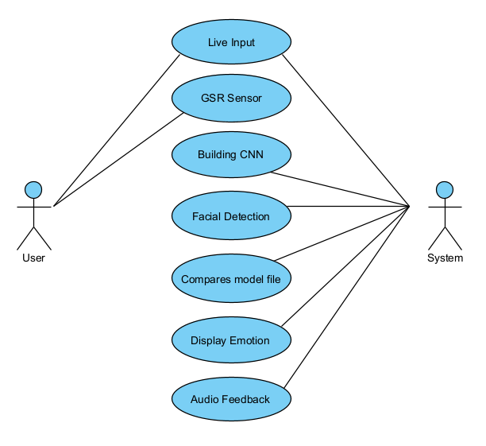
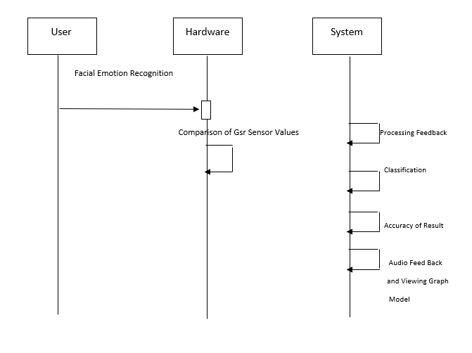
SYSTEM DESIGN
USECASE DIAGRAM SEQUENCE DIAGRAM

Slide 12
MODULE DESCRIPTION
Facial Emotion Prediction
Sweat level prediction
Audio Playing module
Hardware Integration module
Embedded C module
Result and Testing

Slide 13


MODULE DESCRIPTION
Facial Emotion prediction : OpenCV uses machine learning algorithms(CNN and Haar cascade) to search for faces. By getting live input from the subject using OpenCV the facial emotion is detected and it is converted into a grayscale image for accurate prediction using haar cascade. And the region of interest for this project is mouth and lip with which emotion is predicted.

Slide 14
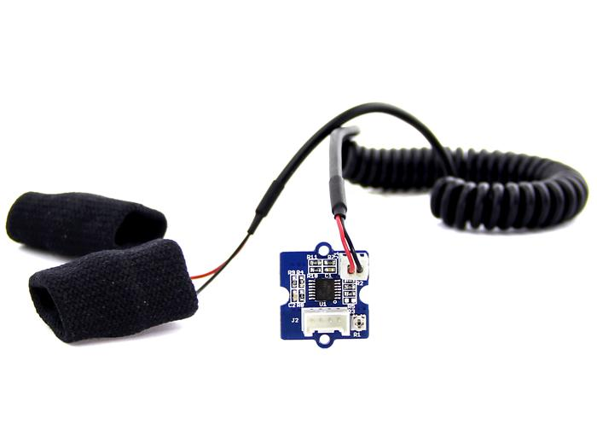
MODULE DESCRIPTION
Sweat level prediction : Sweat level is predicted using GSR Sensor. GSR stands for galvanic skin response, and it is a method of measuring the electrical conductance of the skin. Strong emotion can cause stimulus to your sympathetic nervous system, resulting in more sweat being secreted by the sweat glands. Grove - GSR allows you to spot such strong emotions by simply attaching two electrodes to two fingers on one hand. By simply wearing a band on two fingers. If the conductance is above 80 then the subject is sad. If the conductance is below 80 the subject is happy/neutral. By predicting the sweat level the emotion is predicted

Slide 15


MODULE DESCRIPTION
Audio playing module: Audio plays in response to the Autism children’s Emotion is predicted. If the child is happy it plays calming audio and when the child is sad it plays clapping Audio. This module is to train the ASD children to adjust and develop in a closed and crowded environment. Audio playback files can be changed according to individuals, in this project for happy the audio playback module plays rhyme and for sad the audio playback module plays clapping sound to boost the subject’s state of mind/mood.

Slide 16
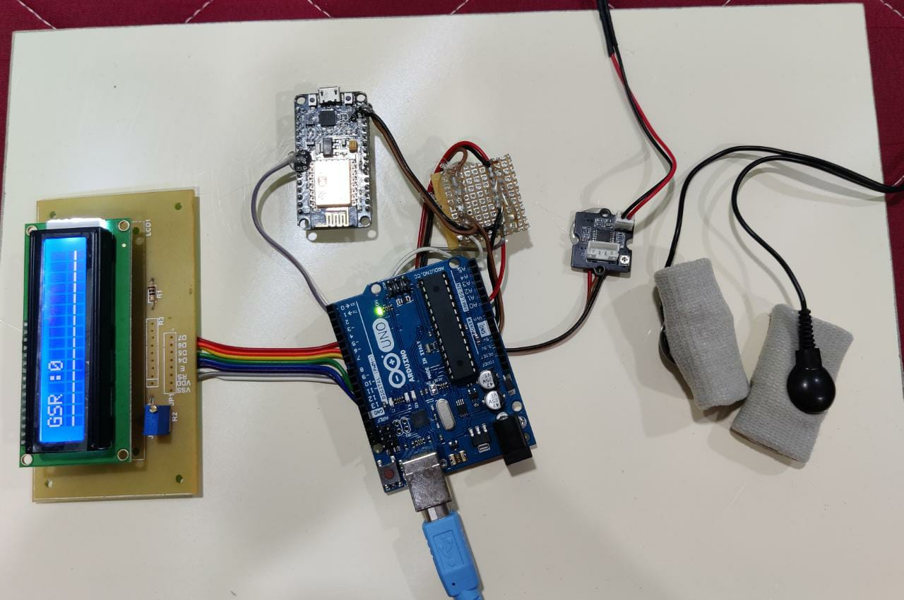

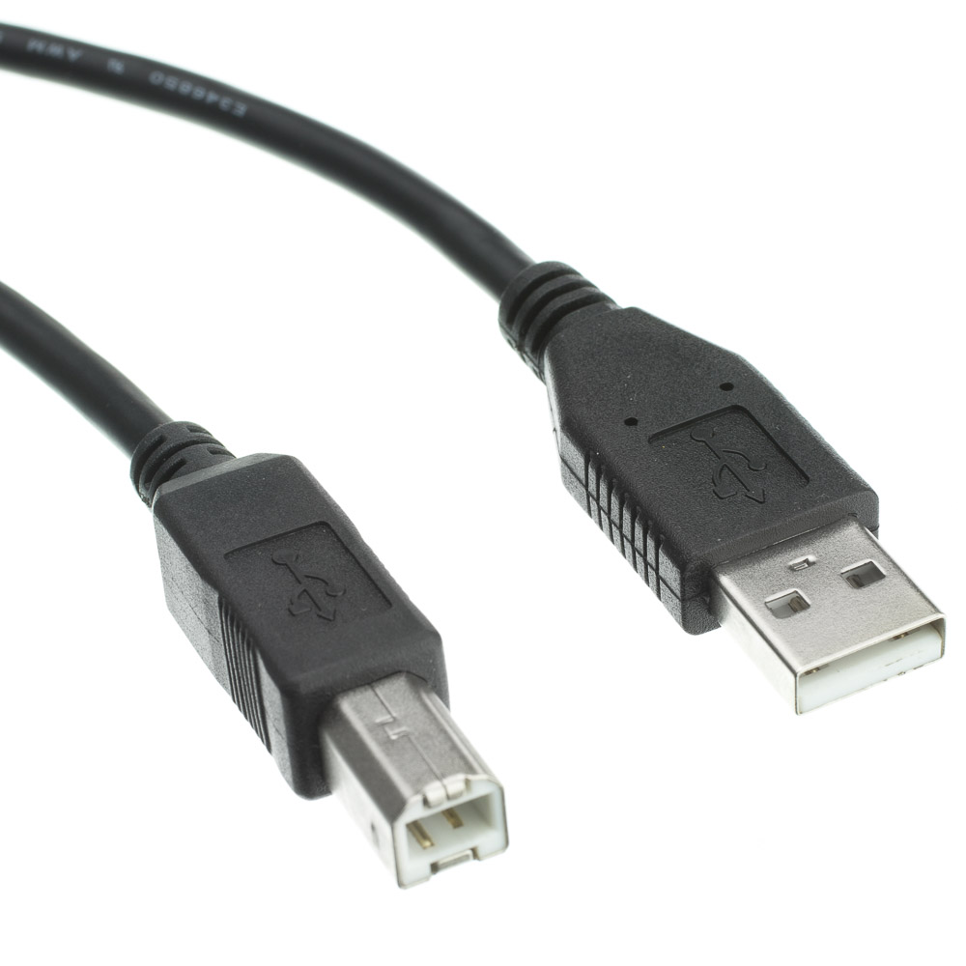
MODULE DESCRIPTION
Embedded C: It is an extension of the C language and is used to develop micro-controller-based applications . We use this embedded c to connect Ardunio.
Hardware Integration: Hardware integration is the process of writing software that connects with one or more pieces of physical hardware to make a single usable system. LCD display, Arduino Mega, Node MCU, GSR Sensor, Power Supply is connected to system using A to B cable . The software used is python in this project, which is connected to the hardware of the project using node MCU through WIFI.

Slide 17
MODULE DESCRIPTION
Result and Testing: We perform a series of tests by taking live input. The Average value from face detection and GSR sensor will be considered, With which we measure the accuracy. The values are stored in the cloud in “ThingSpeak” platform. The admin can change the Channel settings and set it as private, public, etc. They can also download the values in the form of an Excel sheet. Parents can download “ThingView Free” from Playstore. They are able to view the emotional changes of children in the form of a graph along with GSR values. This will be helpful for later study and development.

Slide 18
PERFORMANCE ANALYSIS
The Performance of Haar cascade, CNN and GSR Sensor was estimated with classification performance of the Average Received values, Neutral, Happy and Sad.
The Performance of having Two Powerful Technologies Machine Learning and Embedded Systems integrated with Internet of Thing platform helps in Providing Rapid Solution to Kids with Autism by playing their Rhymes based on the values received from both GSR Sensor and the Facial Emotion values.
In this Experiment we found that using GSR Sensor and Facial Emotion Comparison for Audio Based Feedback for Kids are Compared, Matched and the data are stored correctly and we are getting 95% accuracy on the tested data.

Slide 19

SCREENSHOTS
Hardware components:
LCD display, Arduino Mega, Node MCU, GSR Sensor, Power Supply
Data exported from Cloud in .csv

Slide 20
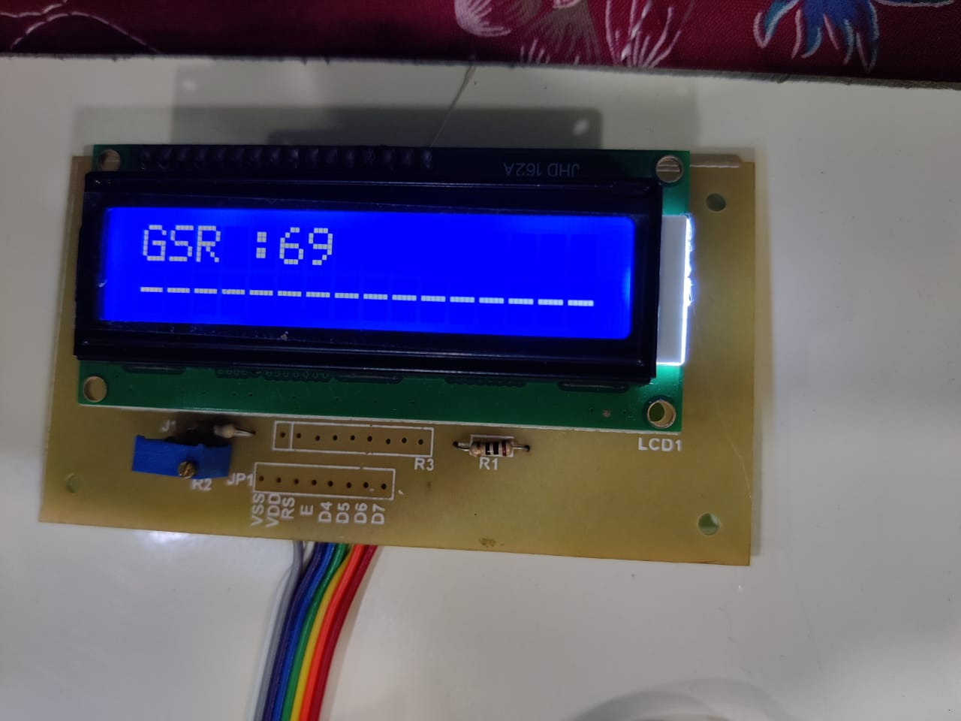
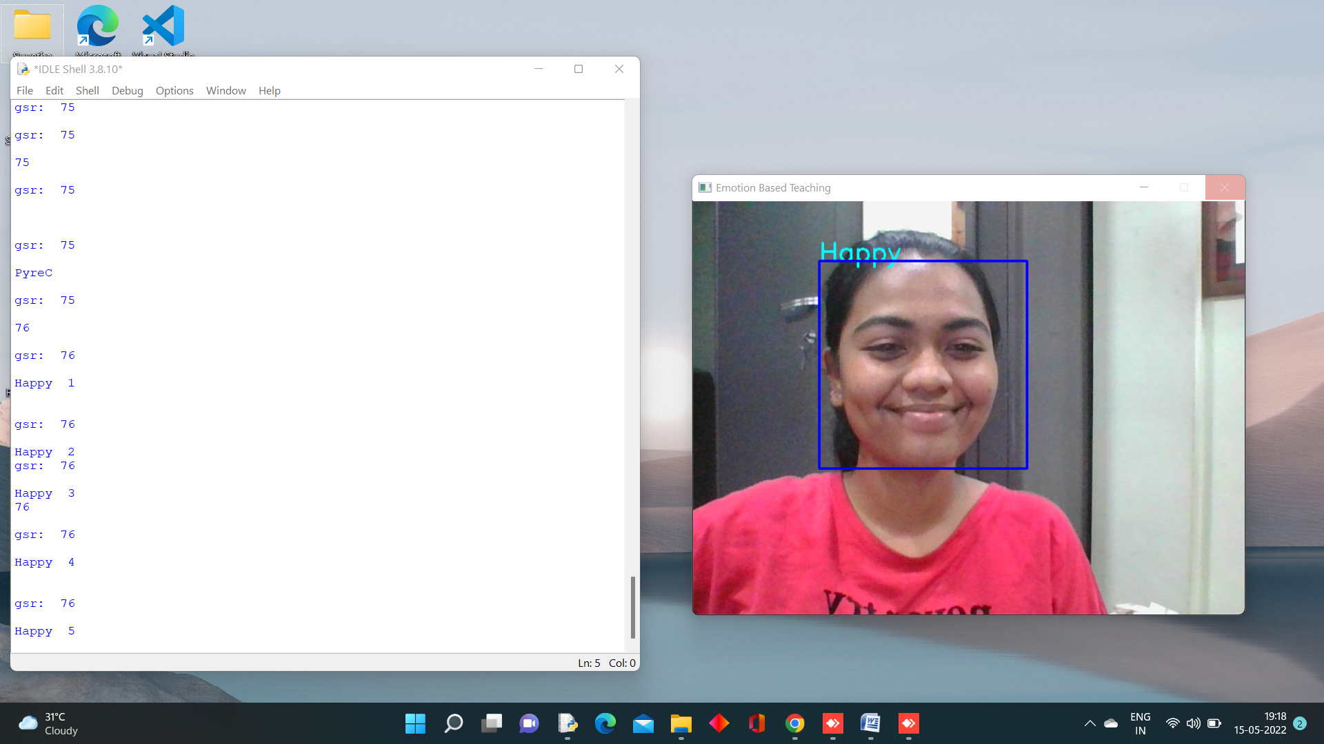
SCREENSHOTS
Screen when happy is predicted
GSR when happy is predicted

Slide 21
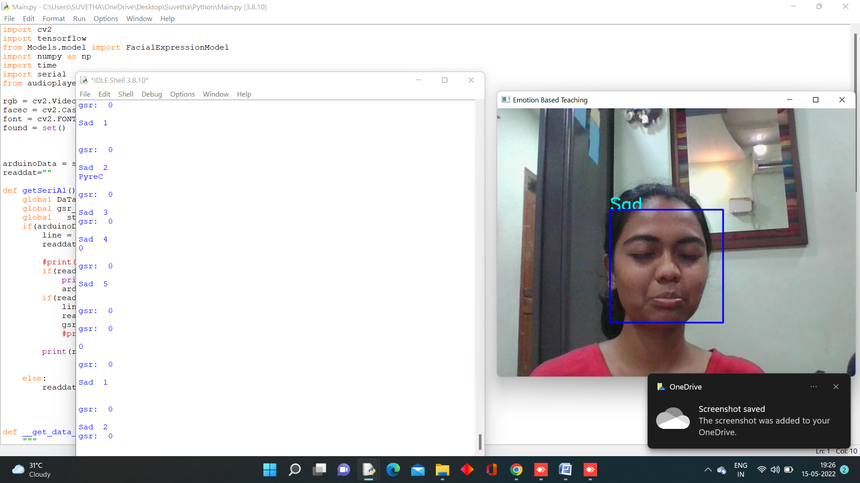
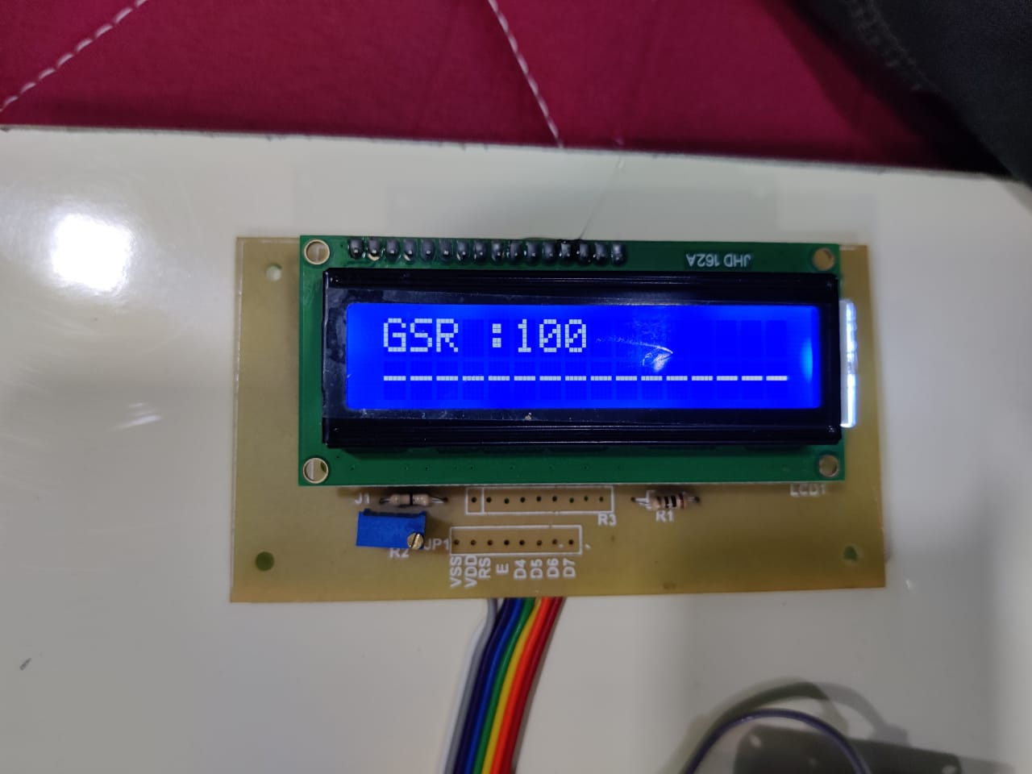
SCREENSHOTS
Screen when sad is predicted
GSR when sad is predicted

Slide 22
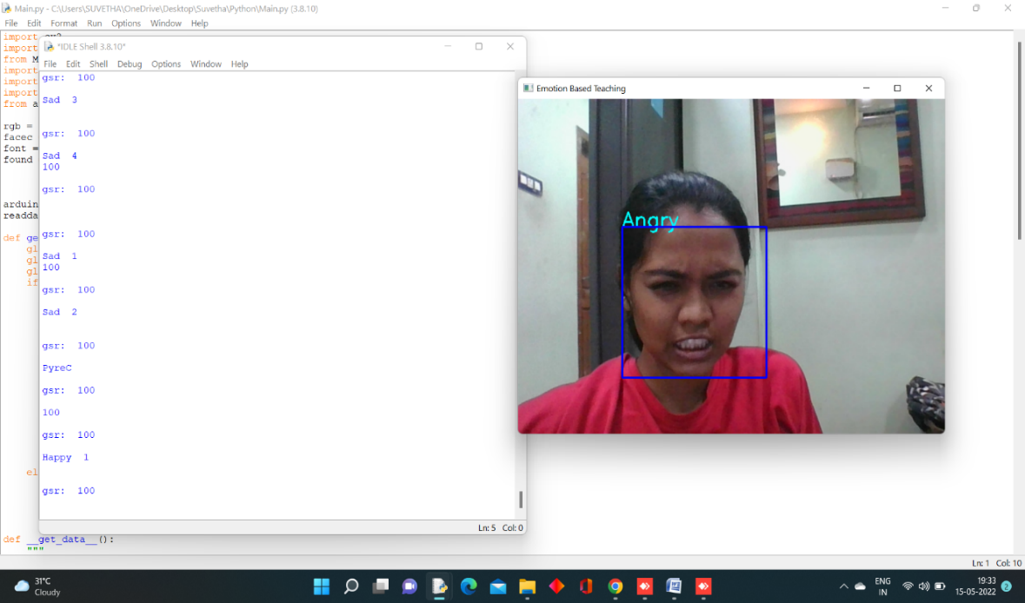
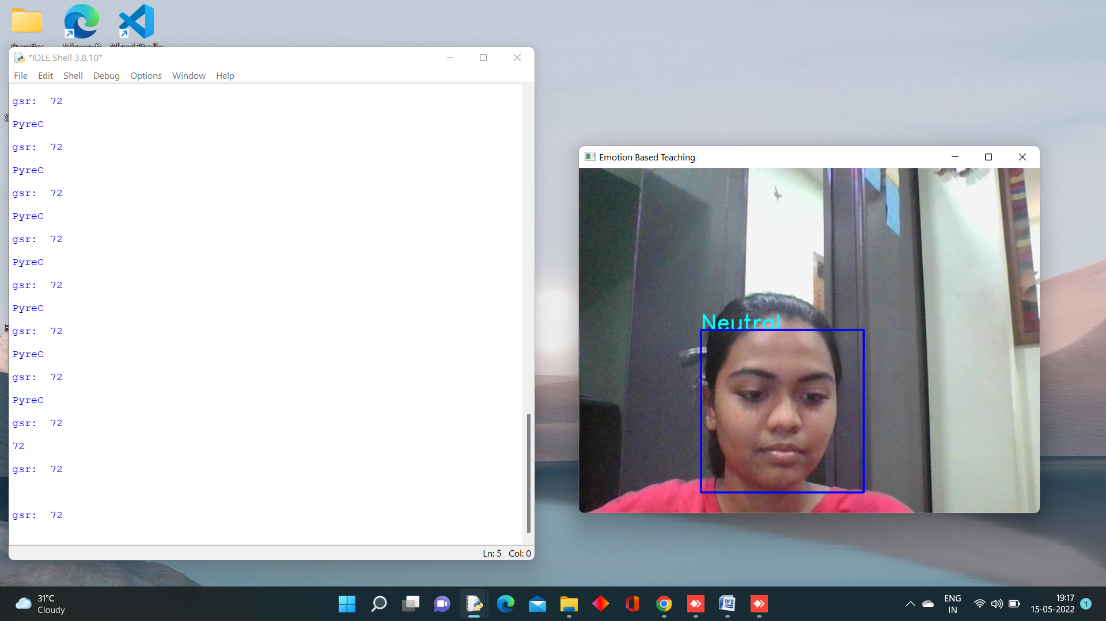
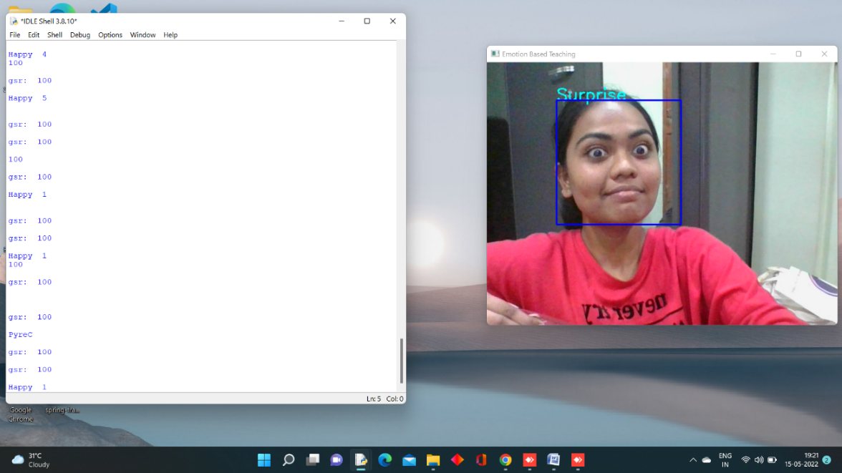
SCREENSHOTS
Screen when neutral is predicted
Screen when angry is predicted
Screen when suprise is predicted

Slide 23
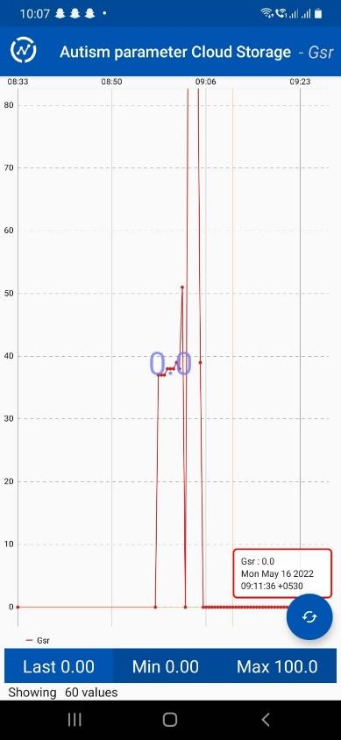
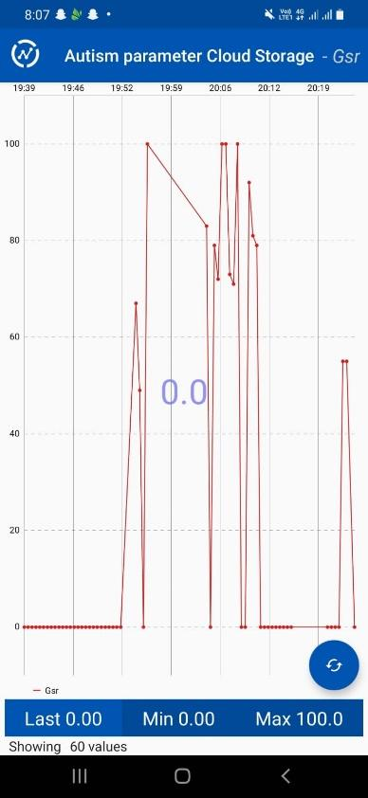

SCREENSHOTS
ThingView application from Parents or Therapist side:

Slide 24
CONCLUSION
In the proposed System we have Tested Facial Expression using Convolution Neural Network Prediction and comparing the output with Galvanic Skin Response sensor to analyze the Emotion level of the Kid with ASD we were able to predict the Emotion in 2 ways (GSR, Facial emotion), and compare the values for Audio Feedback. The system has higher success rate.
In the Future, we can combine Pulse Rate Sensor and Restless Detection along with a Non-Invasive Therapy system which will help us to analyze in-depth data and by providing them with a no-invasive rehabilitation therapy for Immediate Relief.
This can also be upgraded into a Online Learning Platform for Autistic kids. There are various ways we can enhance this project.

Slide 25
REFERENCES
[1] Guangtao Nie and Akshith Ullal , Zhi Zheng , Amy R. Swanson , Nilanjan Sarkar, “An Immersive Computer-Mediated Caregiver-Child Interaction System for Young Children With Autism Spectrum Disorder” IEEE, 978-1-7281-4245-6, VOL 29, 2021.
[2] V. Y Tittagalla, R. R. P Wickramarachchi, G. W. C. N. Chandrarathne, N. M. D. M. B. Nanayakkara, P. Samarasinghe, P. Rathnayake and M.G.N.M. Pemadasa. “Screening Tool for Autistic Children”, IEEE, 978-5386-7512-0, 2019
[3] Alanoud Bin Dris, Abdulmalik Alsalman, Areej Al-Wabil, Mohammed Aldosari, “Intelligent gaze-based screening system for autism”, IEEE, 978-1-7281-0108, 2019
[4] Sarah Afiqh Mohd Zabidi, Hazlina Md Yusof, Sukreen Hana Herman, Shahrul Naim Sidek, “Simple Touch Sensor-based Game as Ambient Assistive Device for Mild Autism Spectrum Disorder Children” , IEEE, 978-1-7281-4245-6-6-21, 2021

Slide 26
REFERENCES
[5] Zeyad Abdulhameed Taha Ahmed , Dr. Mukti E. Jadhav, “A Review of Early Detection of Autism Based on Eye- Tracking and Sensing Technology”, IEEE, ISBN:978-1-7281- 4685-0, 2020
[6] Shirajul Islam, Tahmina Akter, Sarah Zakir, Shareea Sabreen, Muhammad Hossain, “Autism Spectrum Disorder Detection in Toddlers for Early Diagnosis Using Machine Learning”, IEEE, 978-1-6654-1974-1, 2020
[7] Uzma Hasan , Md. Fourkanul Islam , Muhammad Nazrul Islam , Sifat Bin Zaman , Shaila Tajmim Anuva, Farhana Islam Emu, and Tarannum Zaki, “Towards Developing an IoT Based Gaming Application for Improving Cognitive Skills of Autistic Kids”, IEEE, 411-423, 2020.
[8] Joao F. Santos, Nirit Brosh , Tiago H. Falk1 , Lonnie Zwaigenbaum, Susan E. Bryso , Wendy Roberts , Isabel M. Smith , Peter Szatmari and Jessica A. Brian, “Very Early Detection Of Autism Spectrum Disorder Based On Acoustic Analysis Of Pre-Verbal Vocalization Of 18-Month Old Toddlers”, IEEE, 978-1-4799-0356-6, 2013

